Slide 1
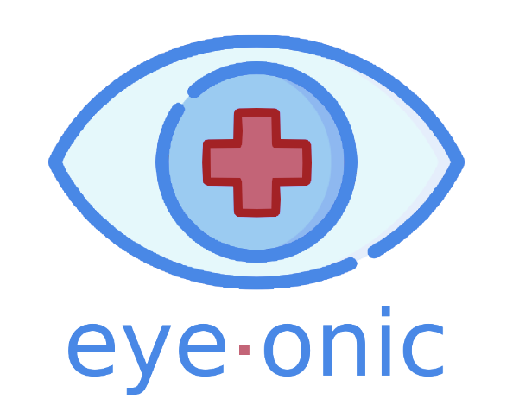
Your First Line of Eye Care
Team Banana tower power

Slide 2
Problem: Wasteful clinical care^{[1]}
1-in-4 ER visits for eye-related problems are not actually emergencies
Some patients receive repeated diagnostic tests or services, simply because information is not shared across providers
Patients also receive “low-value care”: care that is ineffective, or that works for only some groups of patients
[1]: https://www.oecd.org/els/health-systems/Tackling-Wasteful-Spending-on-Health-Highlights-revised.pdf
Notes:
https://www.oecd.org/els/health-systems/Tackling-Wasteful-Spending-on-Health-Highlights-revised.pdf

Slide 3
Problem: Health Disparity ^{[2]} and Misinformation^{[3,4]}
Certain populations, like younger people, men, those with lower incomes or dementia, and people of color, were more likely to seek emergency care for these non-emergency conditions
Distrust of the health care system is relatively high in the general population in the United States and is strongly associated with worse self-reported health
Misinformation concerning healthcare spreads easily on social media
[2]: https://www.sciencedaily.com/releases/2017/02/170214163629.htm
[3]: https://www.ncbi.nlm.nih.gov/pmc/articles/PMC1484714/
[4]: https://www.hsph.harvard.edu/ecpe/vaccines-social-media-spread-misinformation/
Notes:
Social media platforms are usually free and accessible, and information is not vetted as with a news source.

Slide 4
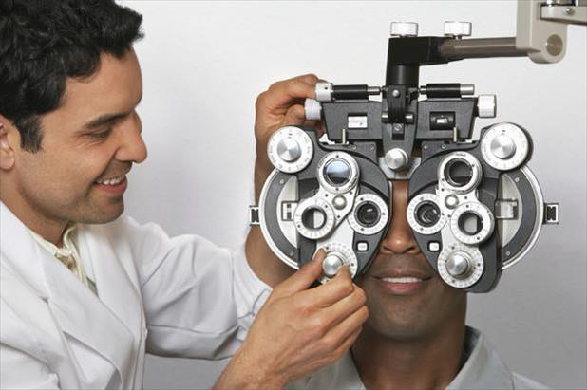

Solution: Technology
“The ER system could be saved millions if we can find a way to increase optometry or ophthalmology visits.”
- Dr. Greg Aker
Our solution is to leverage technology to close the demographic bias
Powered by machine learning, eye-onic seeks to deliver accurate predictions free of biases and facilitate decision-making
“I wasn’t sure what was wrong with my eye, but it didn’t hurt. I didn’t have enough time to go to a doctor, so I didn’t.”
- Carol Hakeem

Slide 5
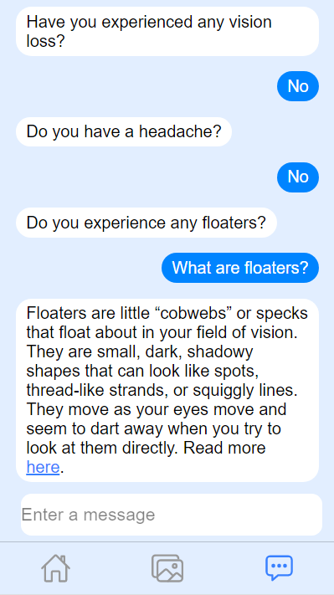
Solution: Accessibility^{[2]} and Education^{[3]}
eye-onic offers a chatroom with our eye-expert bot, Electron
Electron provides eye-onic users an informal, initial diagnosis after prompting for further information in a conversational manner
Electron offers a safe, confidential space to users to have their qualms addressed and to ask eye care-related questions—all in the convenience of a mobile app.
[2]: https://www.sciencedaily.com/releases/2017/02/170214163629.htm
[3]: https://www.ncbi.nlm.nih.gov/pmc/articles/PMC1484714/
Notes:
https://www.sciencedaily.com/releases/2017/02/170214163629.htm

Slide 6
Potential Market Landscape
$87.252B
41,000 Optometrists
30 cases/day
$13.084B
15% of patients unnecessarily see a doctor
$1.07B
Assuming we can reach 15% of patients who don’t need to visit a doctor
15% of patients wait too long to see a doctor
Assuming we can reach 5% of patients who need to see a doctor right away
320 days/year
70% at $100/case
30% at $500/case

Slide 7
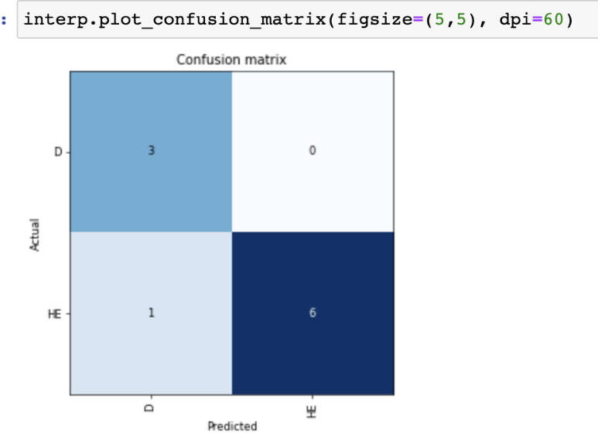
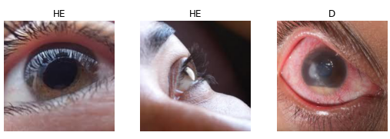
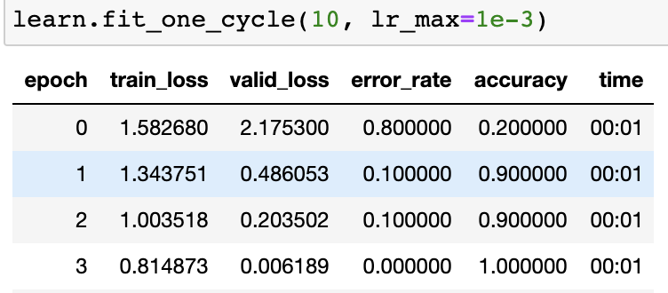
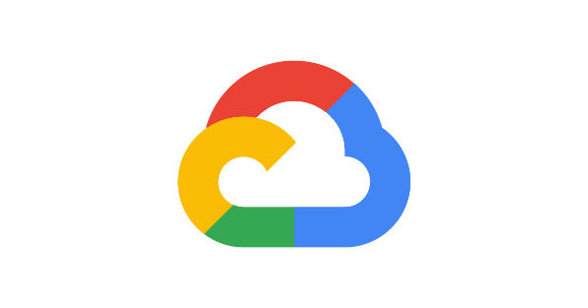



Approach to AI
Created our own data-set through compiling images of healthy and diseased eyes
Techniques used:
Resnet34, one-cycle-policy, fixed precision training, discriminative learning rate, pretrained models

Slide 8
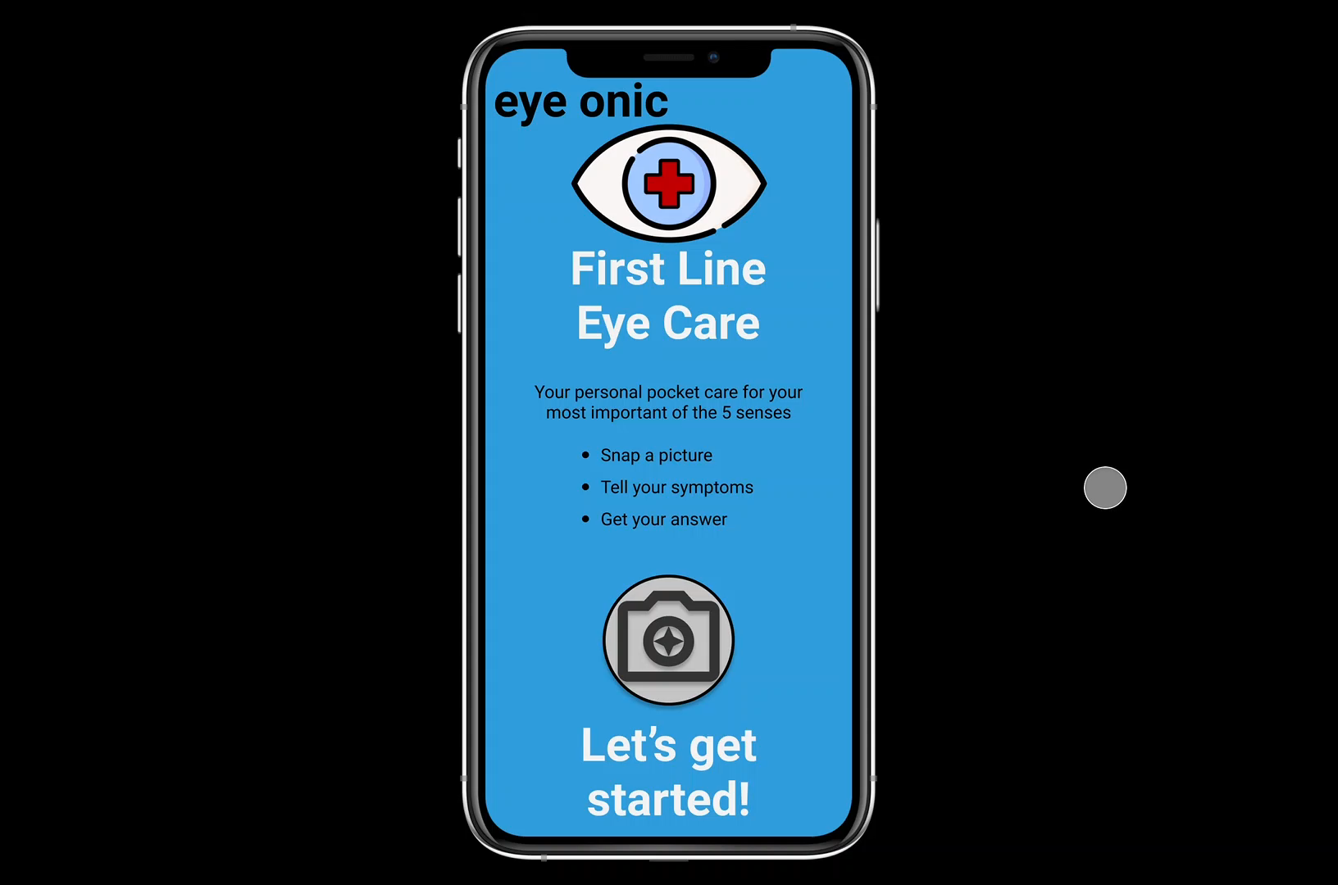
Initial Prototype

Slide 9



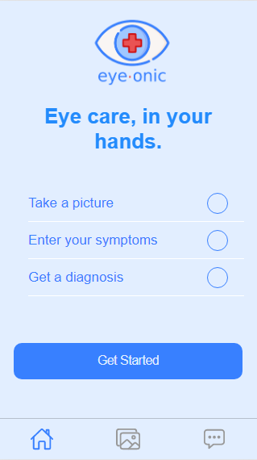
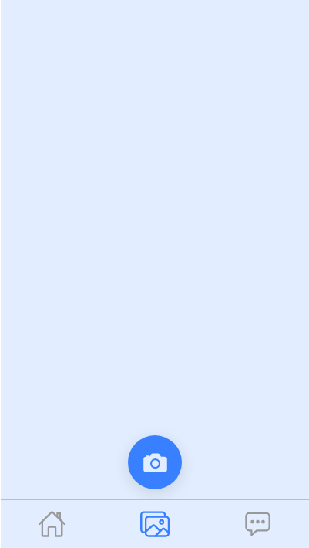
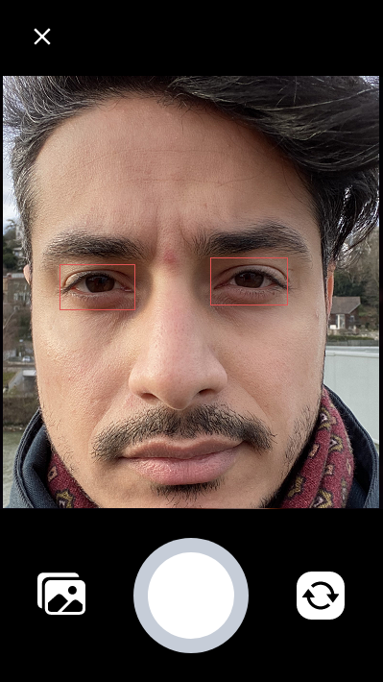
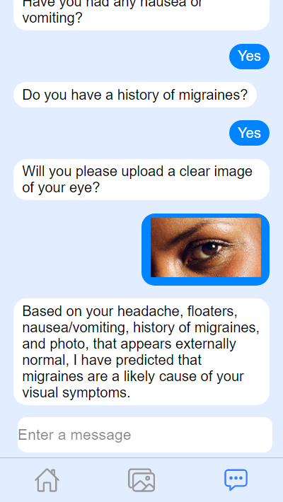
Final Prototype
Notes:
eye-onic's frontend is written in TypeScript and utilizes the Ionic React framework. This allows one codebase to be used for Web, iOS, and Android development! eye-onic's backend consists of machine learning with FastAI, PyTorch, Python and Google Cloud GPUs.

Slide 10
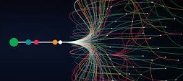
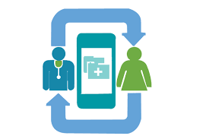
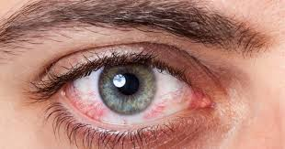
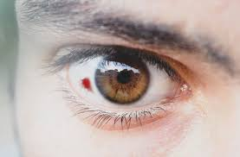
Future Implications
Continuous data collection
Patient follow-up
Increasing the number and accuracy of classifiable disease types
Notes:
## What's next for eye-onic
- Continuous data collection over time
- Establish a pseudonymized data-sharing pipeline to provide insights to medical professionals
- Increasing the dataset size, thus improving the accuracy of classifiable disease types
- We also want to implement a patient follow-up feature after a certain amount of time after an action is suggested

